Slide 1
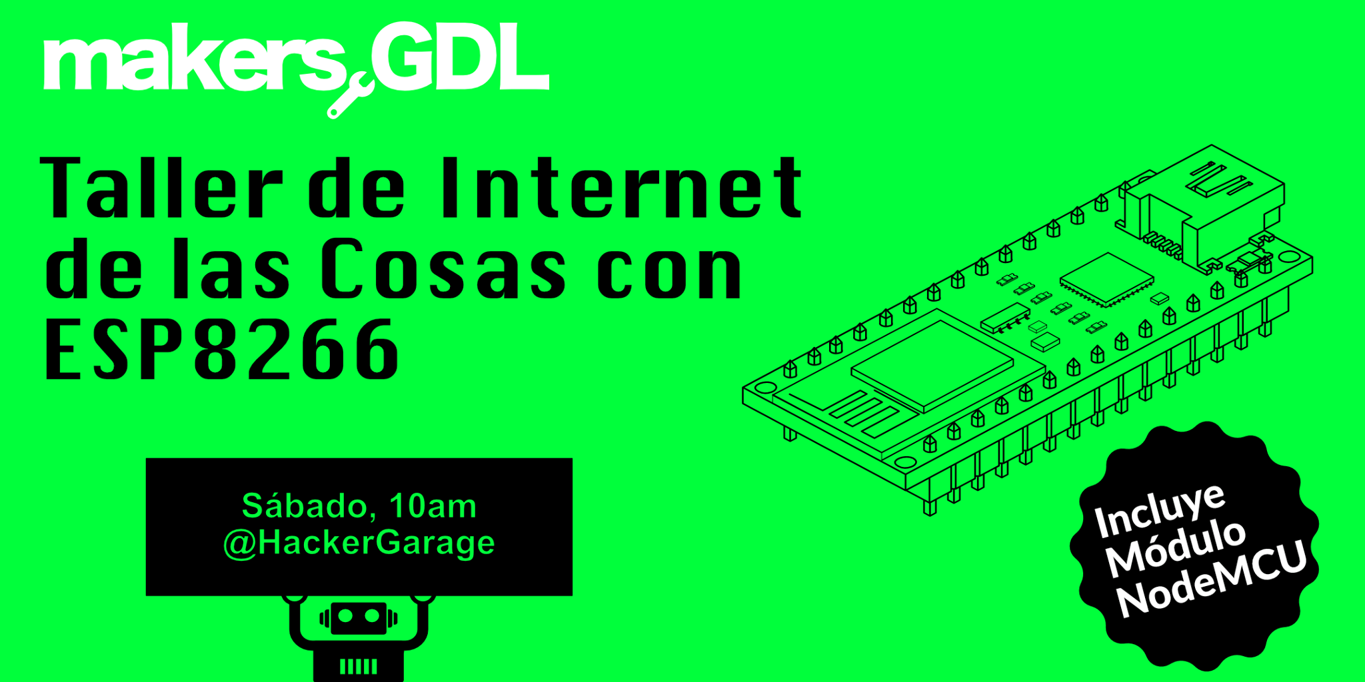

Slide 2


Slide 3


Slide 4


Slide 5
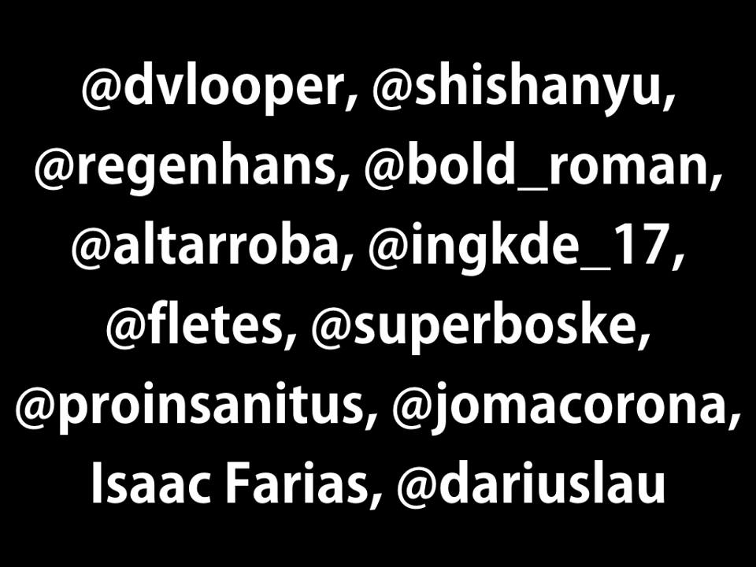

Slide 6


Slide 7
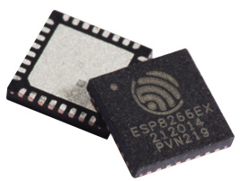
ESP8266

Slide 8
Hardware Specifications
Type | Value
CPU | Tensilica L106 (32-bit @ 160 MHz)
Peripheral Interface | UART/SDIO/SPI/I2C/I2S/IR Remote Control GPIO/ADC/PWM
Operating Voltage | 2.5V ~ 3.6V
Operating Current | Average value: 80 mA

Slide 9
Wi-Fi Protocols
802.11 b/g/n/e/i support
Wi-Fi Direct (P2P) support
WPA/WPA2 PSK, and WPS driver

Slide 10
IEEE 802.11
IEEE 802.11 is a set of media access control (MAC) and physical layer (PHY) specifications for implementing wireless local area network (WLAN) computer communication in the 900 MHz and 2.4, 3.6, 5, and 60 GHz frequency bands.
WPA/WPA2
Wi-Fi Protected Access (WPA) and Wi-Fi Protected Access II (WPA2) are two security protocols and security certification programs developed by the Wi-Fi Alliance to secure wireless computer networks.

Slide 11
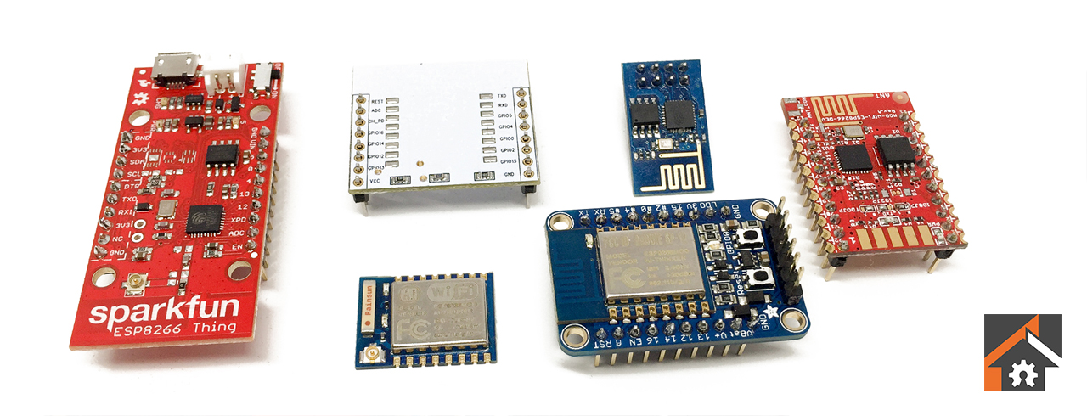
ESP8266 Flavors

Slide 12
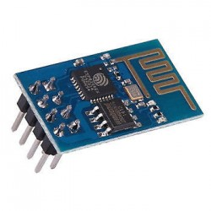
ESP-01

Slide 13
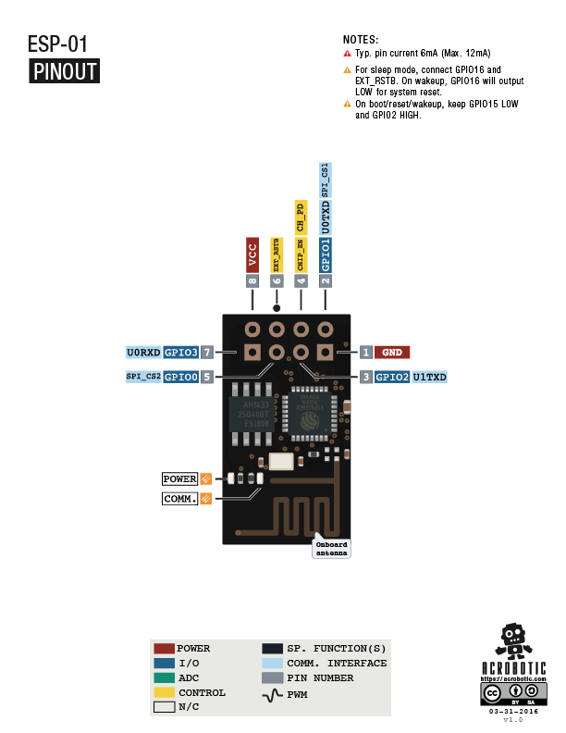

Slide 14
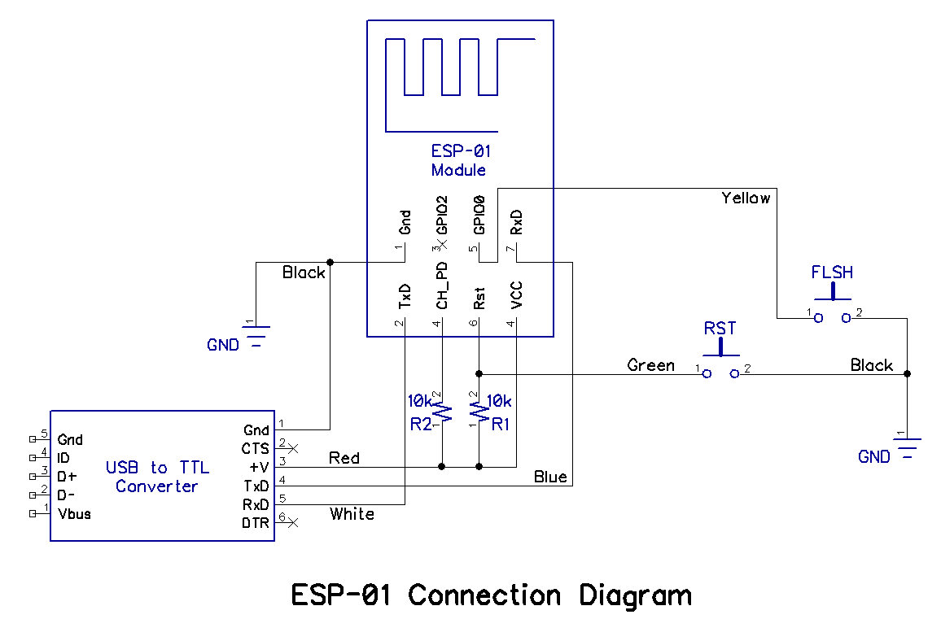
Programming ESP-01

Slide 15
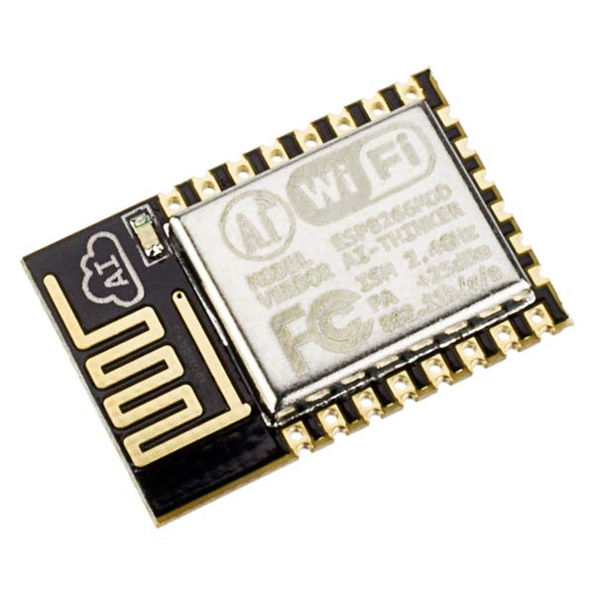
ESP-12E

Slide 16
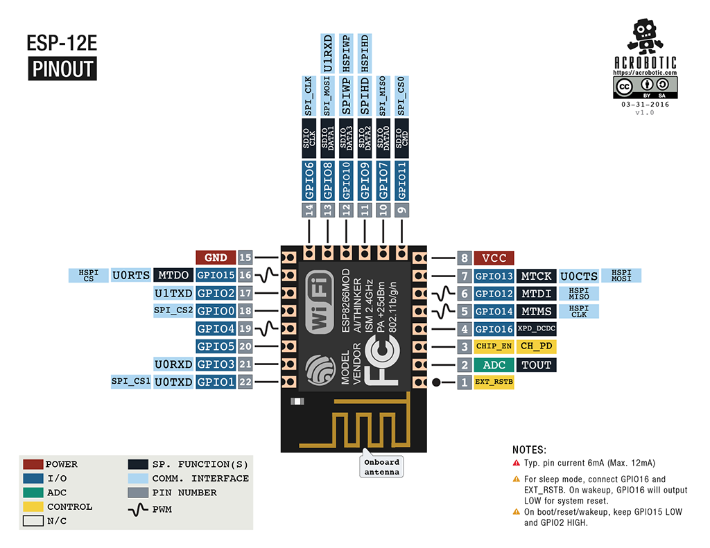

Slide 17
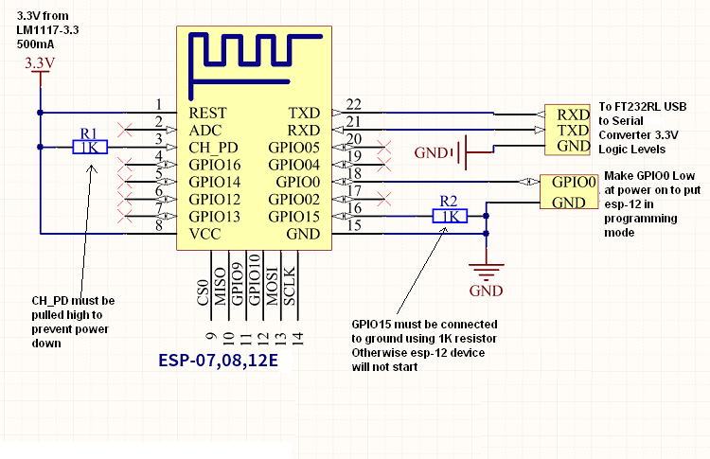
Programming ESP-12E

Slide 18
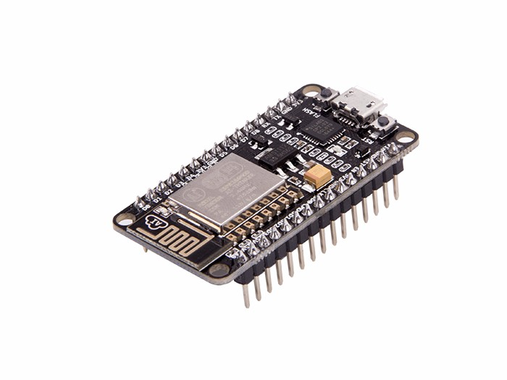
NodeMCU

Slide 19
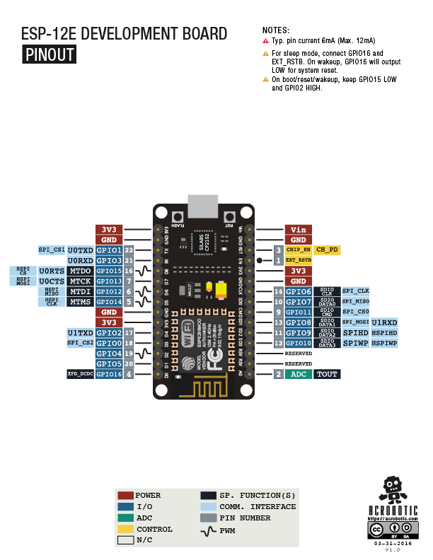

Slide 20
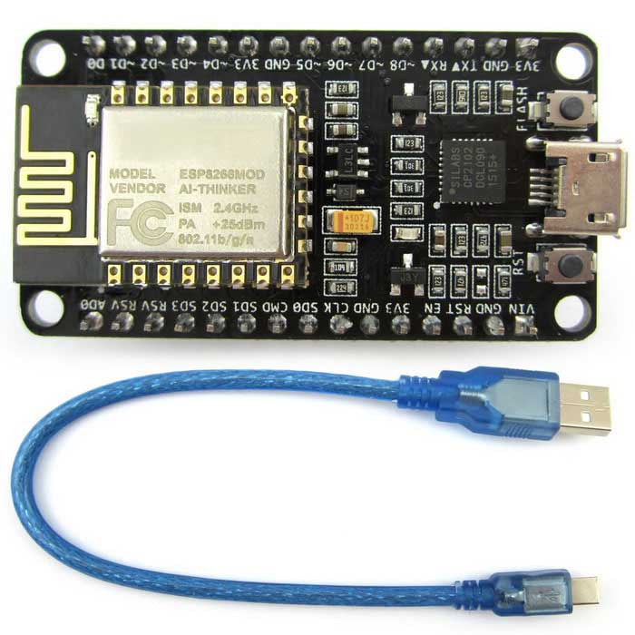
Programming NodeMCU
CP2102 USB-UART (VCP)

Slide 21
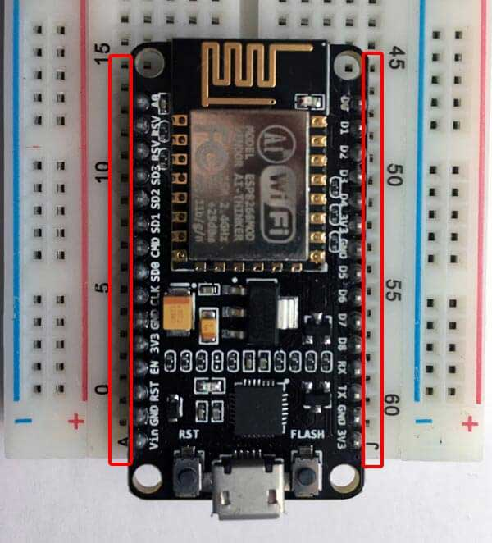
NodeMCU v2 is Protoboard friendly

Slide 22
Firmware options:
Offical ESP8266 AT Firmware
Espressif FreeRTOS Firmware / SDK
NodeMCU Lua Based Firmware
Micro Python
Arduino core for ESP8266
Visuino
ESP-Lisp
Espruino
Sming
ESP8266 Basic
ESPWebFramework

Slide 23
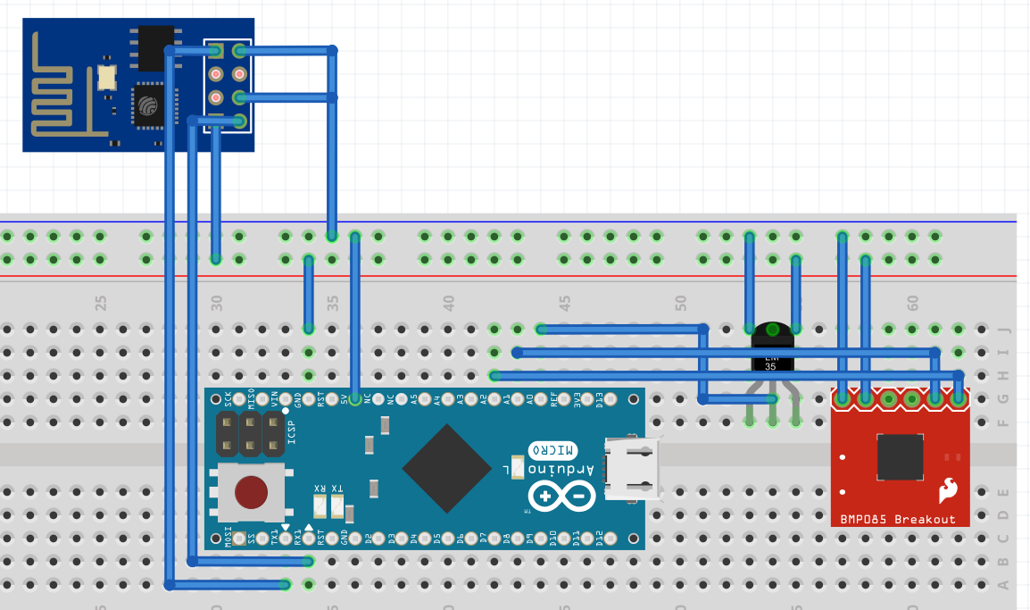
Slave Mode (AT Commands)
Sensors
uC
ESP8266
Internet
UART
Wi-Fi
Display

Slide 24
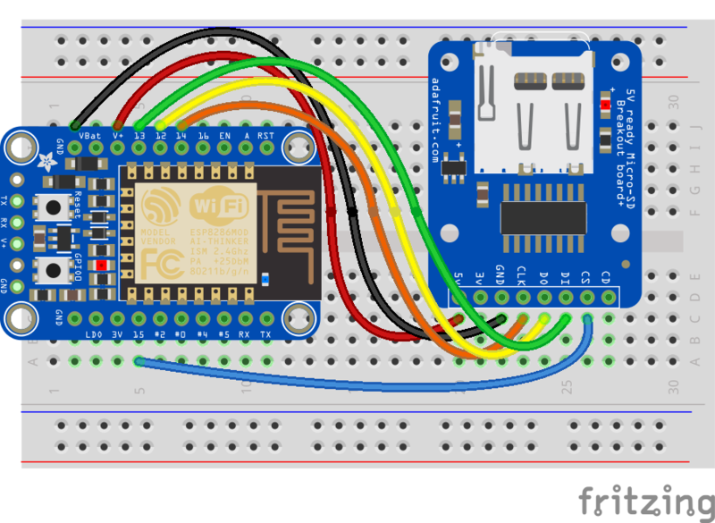
Standalone Mode
Sensors
ESP8266
Internet
Wi-Fi
Display

Slide 25
Hands on NodeMCU

Slide 26
Prerequisites:
NodeMCU Module
USB to Micro USB cable
Computer (Win OS) with Internet Connection
Arduino IDE 1.6.4+

Slide 27
Configuration Steps:
Download and Install the USB to UART driver, it may vary from one board version to another, the most common are:
CP2102
https://goo.gl/LUicA4
CH341
https://goo.gl/2sfubc

Slide 28
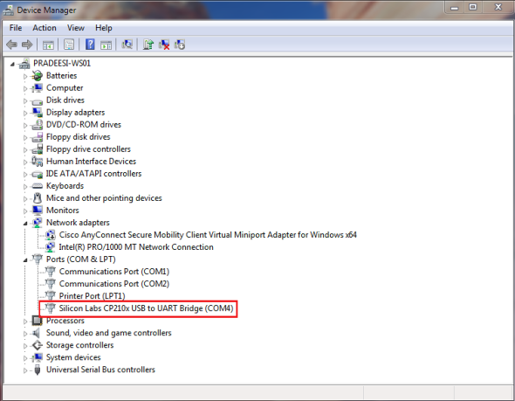
Once the driver was installed a new COM port
should appear on your Device Manager.

Slide 29
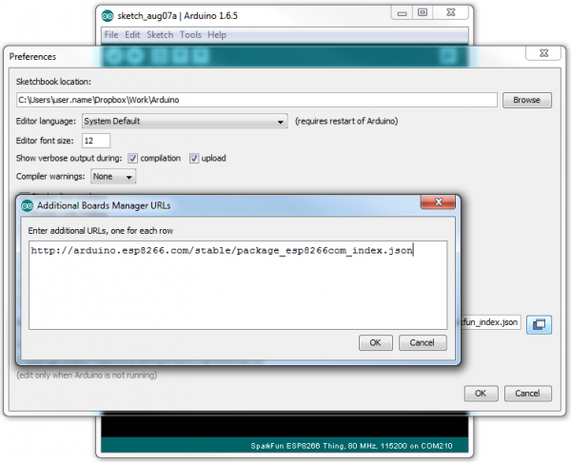
Install the ESP8266 Arduino Addon.
Open up Arduino, then go to the Preferences (File> Preferences). Then, towards the bottom
of the window, copy this URL into the “Additional Board Manager URLs” text box:
http://arduino.esp8266.com/stable/package_esp8266com_index.json

Slide 30
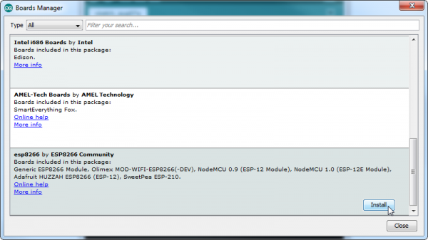
Then navigate to the Board Manager by going to:
”Tools > Boards > Boards Manager”.
There should be a couple new entries in addition to the standard Arduino boards. Look for esp8266.
Click on that entry, then select Install.

Slide 31
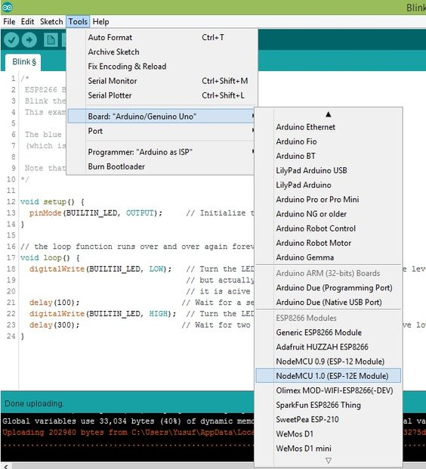
Select the NodeMCU board:
”Tools > Boards > NodeMCU 1.0 (ESP-12E Module)”.

Slide 32
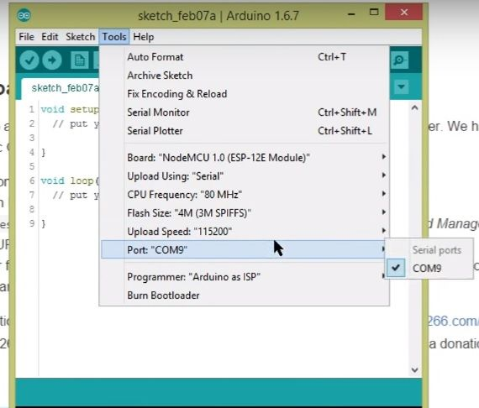
Select NodeMCU COM Port:
”Tools > Port > COM(n)”.

Slide 33
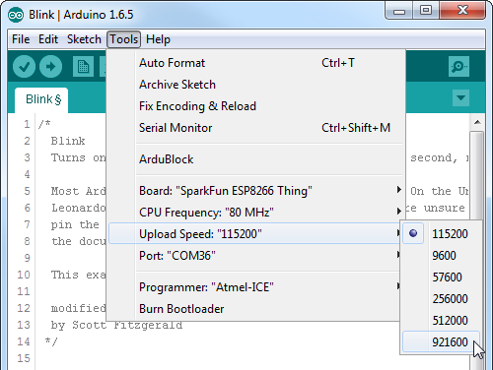
Select NodeMCU Upload Speed:
”Tools > Upload Speed > 921600”.

Slide 34
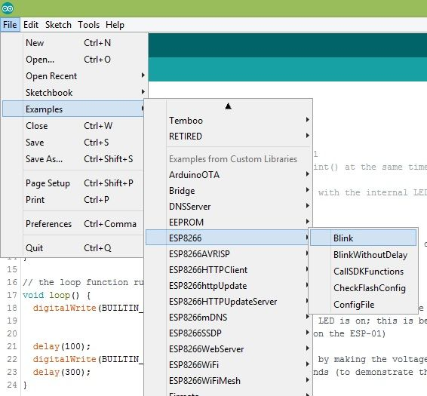
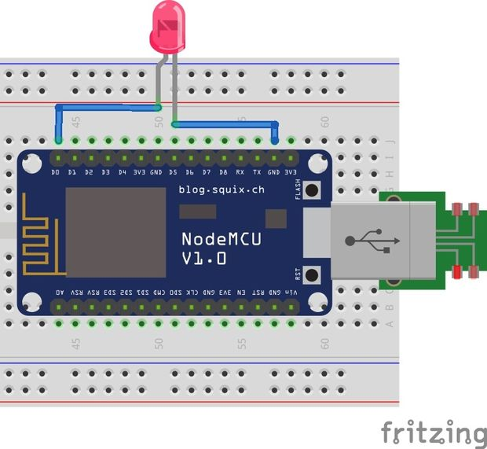
Make it work:
”File > Examples > ESP8266 > Blink”.

Slide 35


Slide 36

Need help with your NodeMCU setup?

Slide 37

Still need help?

Slide 38
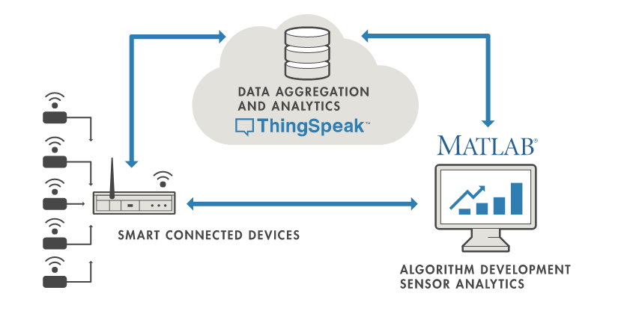

Slide 39
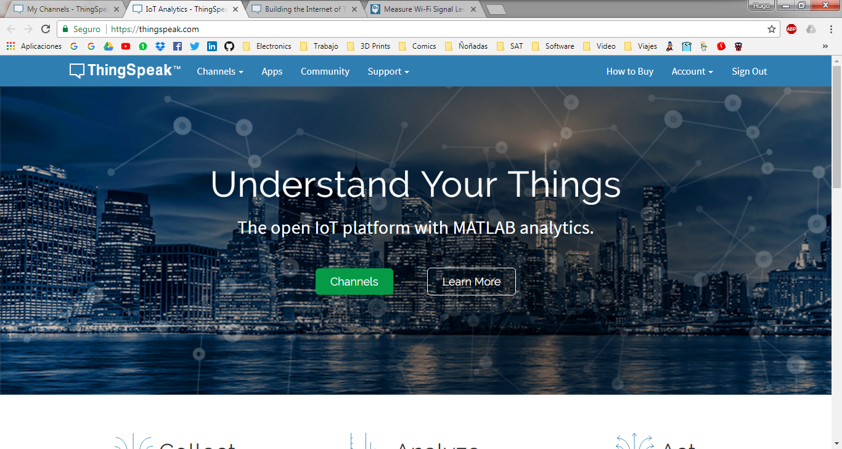
Configuration Steps:
Sign up or register to Thingspeak:
https://thingspeak.com/users/sign_up

Slide 40
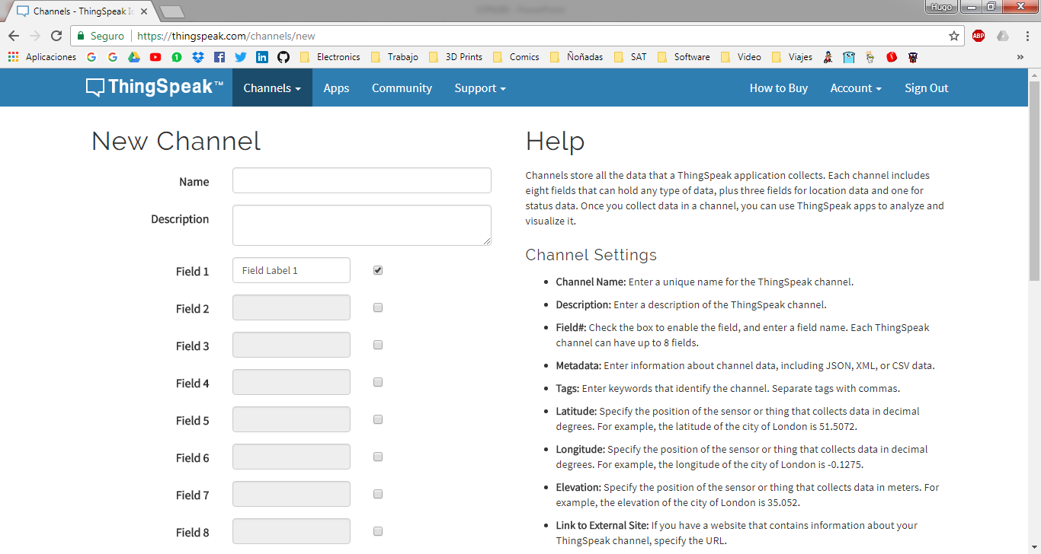
Create a new Channel:
https://thingspeak.com/channels/new

Slide 41
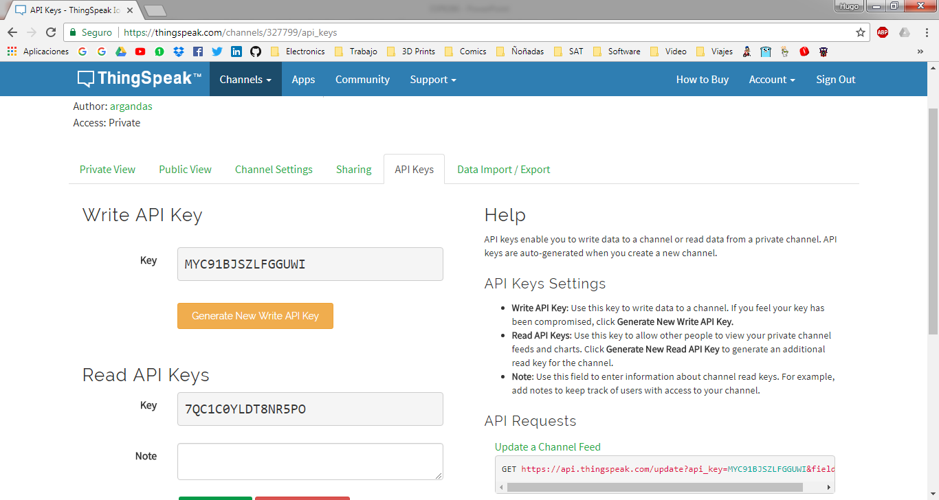
Get your channel API keys:
https://thingspeak.com/channels/<channel_number>/api_keys

Slide 42
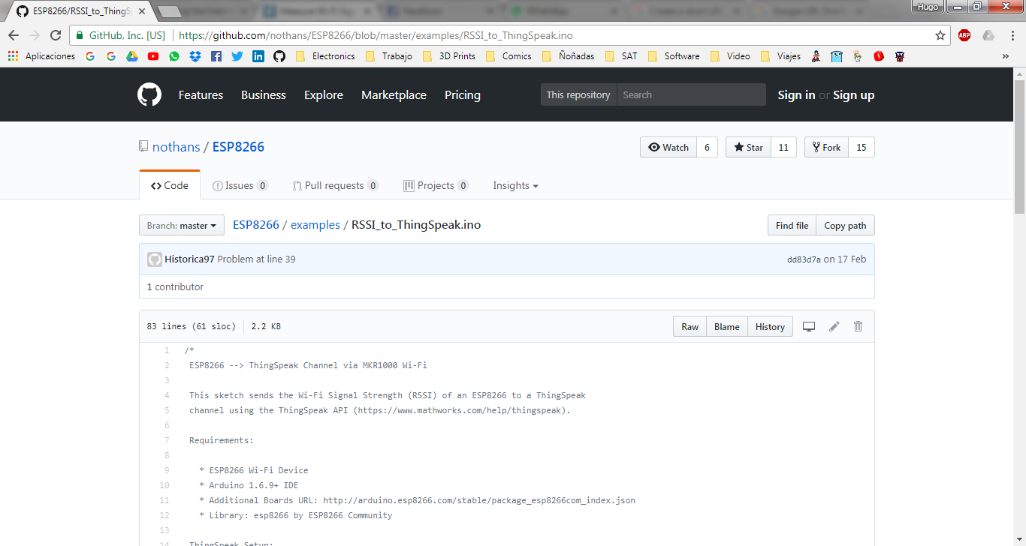
Publish to your channel, download example code from:
https://goo.gl/kkycnr
(https://github.com/nothans/ESP8266/blob/master/examples/RSSI_to_ThingSpeak.ino)

Slide 43
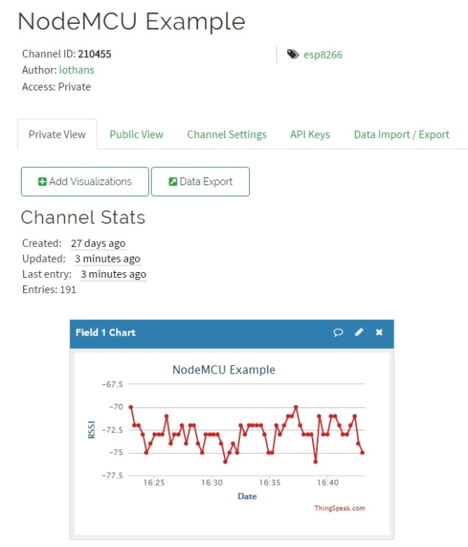
Watch your data live!
https://thingspeak.com/channels /<channel_number>

Slide 44


Slide 45
Understand Thingspeak API
To update a channel feed, send an HTTP GET or POST request to:
https://api.thingspeak.com/update
Example:
POST /update HTTP/1.1
Host: api.thingspeak.com
Connection: close
X-THINGSPEAKAPIKEY: MYC91BJSZLFGGUWI
Content-Type: application/x-www-form-urlencoded
Content-Length: 22
field1=73&field2=100

Slide 46
HTTP (Hypertext Transfer Protocol)
The Hypertext Transfer Protocol (HTTP) is an application protocol for distributed, collaborative, and hypermedia information systems.[1] HTTP is the foundation of data communication for the World Wide Web.
Hypertext is structured text that uses logical links (hyperlinks) between nodes containing text. HTTP is the protocol to exchange or transfer hypertext.

Slide 47

Define “protocol”

Slide 48
Define “protocol”
In information technology, a protocol is the special set of rules that end points in a telecommunication connection use when they communicate. Protocols specify interactions between the communicating entities.

Slide 49
HTTP Requests
GET
The GET method requests a representation of the specified resource. Requests using GET should only retrieve data and should have no other effect
POST
The POST method requests that the server accept the entity enclosed in the request as a new subordinate of the web resource identified by the URI. The data POSTed might be, for example, an annotation for existing resources; a message for a bulletin board, newsgroup, mailing list, or comment thread; a block of data that is the result of submitting a web form to a data-handling process; or an item to add to a database.
PUT
The PUT method requests that the enclosed entity be stored under the supplied URI. If the URI refers to an already existing resource, it is modified; if the URI does not point to an existing resource, then the server can create the resource with that URI.
DELETE
The DELETE method deletes the specified resource.

Slide 50
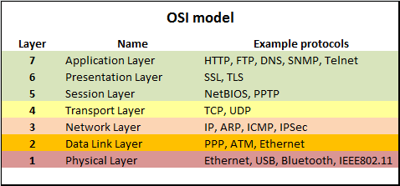
OSI Model (Open Systems Interconnection model)

Slide 51


Slide 52

Q&A Time!

Slide 53


Slide 54
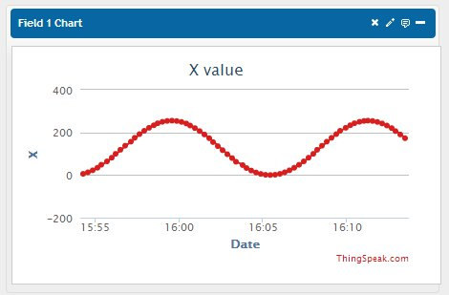
Challenge:
Draw a Sine wave on a Thingspeak chart, at least one complete cycle. No rules on x-y axis range or sample timing, just draw the wave.
Duration: 30 minutes
The first one to show me the full wave and source code wins.
Prize:
Free admission on my next course, materials included & 1 beer...

Slide 55

Gracias por asistir!
Hugo Arganda
hugo.arganda@gmail.com
@argandas
*El 100% de las ganancias han sido donadas para apoyar a MakersGDL

